Slide 1

Politics Towards 2020 Election
by Party Identification
October 2019

Slide 2
Survey Overview
The GenForward Survey, founded by Dr. Cathy Cohen at the University of Chicago, is the first of its kind—a nationally representative survey of over 3,250 young adults ages 18-36 conducted bimonthly that pays special attention to the ways race and ethnicity influence how young adults, both Millennials and Gen-Zers, experience and think about the world.
Given the importance of race and ethnicity for shaping the diverse perspectives and lived experiences of young people, we believe researchers make a mistake when they present data on young adults in a manner that assumes a monolithic Millennial generation and young adult vote.
In this slide deck, we present an empirical overview of young adults’ views on politics in the United States, with a focus toward the 2020 election. A total of 2,994 interviews were conducted between September 27th and October 10th, 2019 with adults ages 18-36, including completed interviews with 833 African American, 527 Asian American, 801 Latinx, and 775 white young adults.

Slide 3
Key Findings
Support of the House of Representatives holding impeachment hearings is strongest among young Democrats with 87% strongly or somewhat supporting A majority of Independents (58%) strongly or somewhat support holding the hearings, and Republicans are less supportive with 33% strongly or somewhat supporting.
Majorities of young adults across parties believe that Donald Trump has definitely or probably improperly used his office to attack his political opponents—with 93% of Democrats, 76% of Independents, and 52% of Republicans agreeing.
Among Democratic young adults, Bernie Sanders is their top Democratic presidential candidate with 26% support, followed by former Vice-President Biden with 17% support .
Among Independent young adults, the top Democratic presidential candidate is Senator Sanders with 10% support followed by Former VP Biden with 6%. However, Independents currently prefer someone else by a large margin, at 50%.
Among Republican young adults, the top Democratic presidential candidate is Former VP Biden with 11%, followed by Senator Sanders with 5%. However, Republicans want someone else by a large margin, at 47%.

Slide 4
Key Findings
Young adults who identify as Independents are the least likely group to say they plan to vote with 26% reporting they definitely or probably will not vote in November 2020. Another 27% of Independent young adults are unsure about whether or not they will vote. Majorities of Republicans (79%) and Democrats (79%) indicate that they probably or definitely will vote in 2020.
The ability to bring about needed change is the most important quality for a candidate in the presidential election with 28% of Democrats, 22% of Independents, and 22% of Republicans registering their preference for that quality.
What young adults believe is the most important issue facing this country today is divided by political party. Among Democrats, the most important issue is the environment and climate change with support from 19% of those surveyed. The environment and climate change is also the most important issue for Independents, tying for the number one position with health care at 10% support. For young-adult Republicans, the main issue is immigration, with support from 12% of Republicans.
Majorities of Democrats (70%) and Independents (56%) believe that it is very or somewhat likely that the United States will enter a recession in the next year. Slightly less than a majority of Republicans (48%) consider an upcoming recession very or somewhat likely.

Slide 5
Key Findings
Democratic and Republican young adults believe that voting gives them a say in how the government runs things—with 63% of Democrats and 58% of Republicans agreeing. In contrast, 60% of Independents believe that their vote does not really affect how the government runs things.
Support for building a wall along the Mexican border is led by Republicans with 71% strongly or somewhat supporting. There is little support among Democrats (17%) and Independents (28%).
A majority of young adult Democrats (67%) support the wealth tax. There is less support among Independents (40%) and Republicans (38%).
Pluralities of young adults across parties support establishing a public option for health care coverage like Medicare-for-all, while allowing people to stay on their private insurance—with 38% of Democrats, 30% of Independents and 31% of Republicans supporting this policy.

Slide 6
Key Findings
Majorities of young adults across parties support free tuition at public colleges—with 80% of Democrats strongly or somewhat supporting this policy followed by 70% of Independents and 55% of Republicans.
Majorities of young adults across party id strongly or somewhat strongly support The Green New Deal--with 89% of Democrats, 69% of Independents and 62% or Republicans registering support.
While majorities of Democrats (76%) strongly or somewhat support banning the sale of selected semi-automatic firearms, majorities of Independents (52%) and Republicans (56%) strongly or somewhat oppose the idea of banning the sale of selected semi-automatic firearms.
Large majorities of young people, across parties, strongly or somewhat favor background checks to buy a gun—with 88% of Democrats, 73% of Independents and 82% or Republicans supporting this policy.

Slide 7
By Party Identification

Slide 8
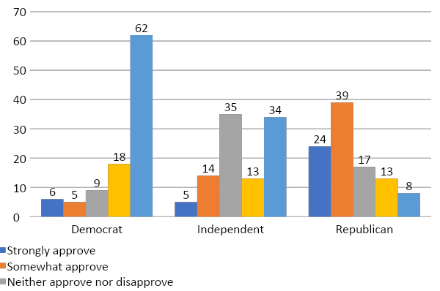
Approval of President Trump
Overall, do you approve, disapprove, or neither approve nor disapprove of the way Donald Trump is handling his job as president?
Approval of President Trump varies by Party-ID with those identifying as Democrats being the most disapproving, followed by Independents. The majority of Republicans approve of the President.
Percent that somewhat or strongly approve:
  Democrats= 11%
  Independents= 19%
  Republicans = 53%

Slide 9
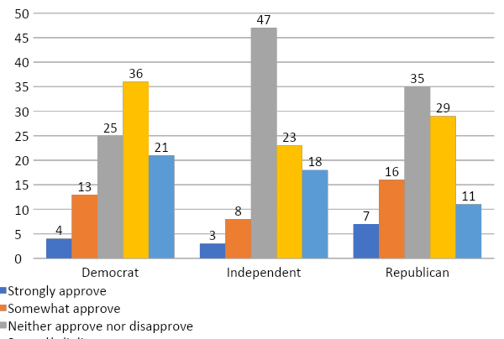
Approval of Congress
Overall, do you approve, disapprove, or neither approve nor disapprove of the way Congress is handling its job?
Pluralities of Independent young adults across parties report neither approving nor disapproving of Congress. Of those who have an opinion, respondents’ evaluations of Congress lean toward disapproval. Republicans are the largest group with a positive response to Congress.
Percent that somewhat or strongly approve:
  Democrats = 17%
  Independents = 11%
  Republicans = 25%

Slide 10
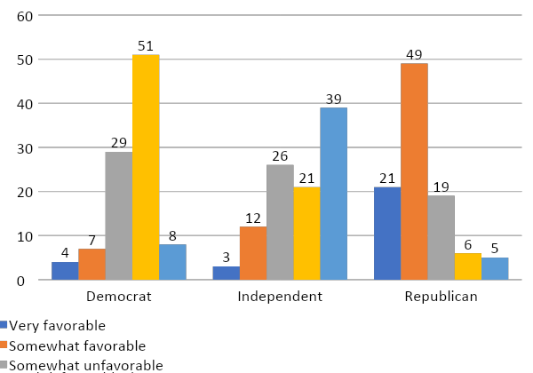
Favorability of the Republican Party
Young adults who identify as Democrats have unfavorable views of the Republican Party, while Republicans are favorable towards their own party. Those who identify as independents are most likely to report that they don’t have enough information to form an opinion.
Percent reporting very or somewhat favorable views:
  Democrats = 11%
  Independents = 15%
  Republicans = 70%
Please select if you have a favorable or unfavorable impression of the Republican Party.

Slide 11
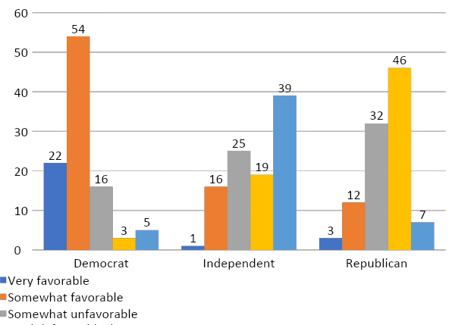
Favorability of the Democratic Party
Please select if you have a favorable or unfavorable impression of the Democratic Party.
When looking at young adults’ view of the Democratic party, those who identify as Democrats have a favorable view, and those who do identify as such, do not have a favorable view. Most Independents report not having enough information to make an opinion. The majority of Republicans have an unfavorable opinion.
Percent reporting somewhat or strongly favorable views:
  Democrats= 76%
  Independents = 17%
  Republicans= 15%

Slide 12
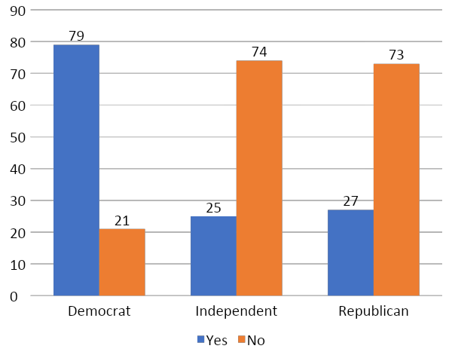
Does the Democratic Party Care about People Like You?
Do you think the Democratic Party cares about people like you, or not?
Substantial majorities of Democratic young adults think that the Democratic Party cares about people like them. Independents and Republicans, on the other hand, believe that the Democratic Party does not care about people like them.

Slide 13
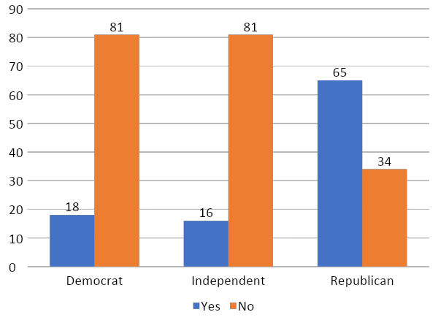
Does the Republican Party Care about People Like You?
Do you think the Republican Party cares about people like you, or not?
Substantial majorities of Democrats and Independents think that the Republican Party does not care about people like them. The majority of Republican young adults, on the other hand, believe that the Republican Party does care about people like them.

Slide 14
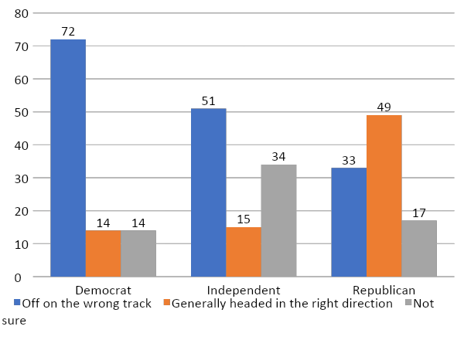
Direction of the country
Would you say things in this country are…
Apart from Republicans, young adults believe that the country is going off on the wrong track, though Democratic young adults are much more likely to think so than their Independent peers. Republican young adults are most likely to say things are heading in the right direction.
Percent who say that things in the country are going off on the wrong track:
  Democrats= 72%
  Independents= 51%
  Republicans = 33%

Slide 15
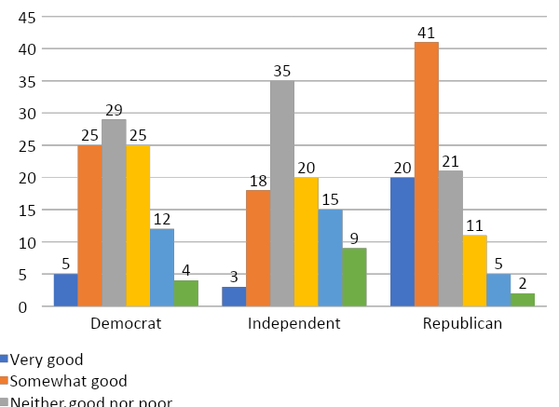
State of the national economy
Republican young adults are much more likely to describe the nation’s economy as doing well. Democratic and Independent young adults are most likely to believe the economy is neither good nor poor.
Percent who say the nation’s economy is very or somewhat good:
  Democrats = 30%
  Independents = 21%
  Republicans = 61%
How would you describe the nation’s economy these days? Would you say…

Slide 16
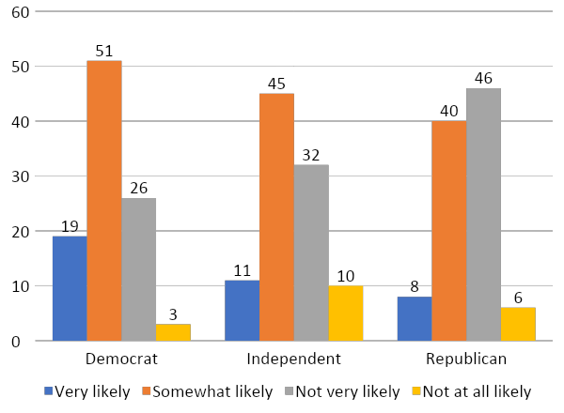
Likelihood of Recession
How likely or unlikely is it that the United States will enter into a recession in the next year?
Majorities of Democrats (70%) and Independents (56%) believe that it is very or somewhat likely that the United States will enter a recession in the next year. Slightly less than a majority of Republicans (48%) consider an upcoming recession very or somewhat likely.
Percent who say the United States is very or somewhat likely to enter into a recession in the next year:
  Democrats= 70%
  Independents = 56%
  Republicans = 48%

Slide 17
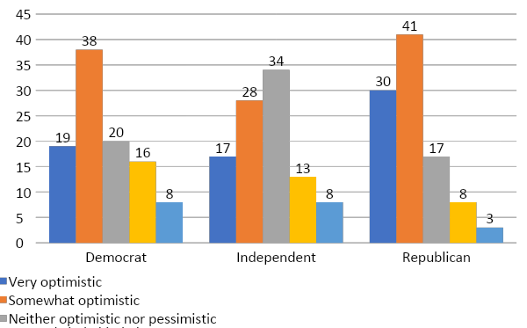
Optimism toward one’s personal economic future
Generally speaking, how optimistic are you about your personal future—think about things like finding and keeping a good job, paying off your student loan debt, and being able to afford the lifestyle you want?
Majorities of both Republicans (71%) and Democrats (57%) are optimistic about their personal futures, while less than a majority of Independents (41%) share in this optimism
Percent who are very or somewhat optimistic about their personal futures:
  Democrats = 57%
  Independents = 41%
  Republicans = 71%

Slide 18
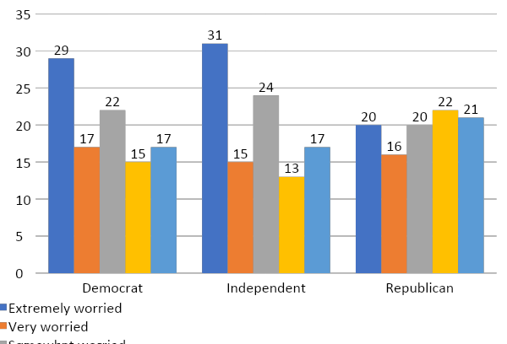
Unexpected Financial Burden
How worried are you about being able to pay an unexpected bill of $1,000 right away?
Pluralities of Democratic and Independent young adults express concern in their ability to pay an unexpected bill. Republicans are more uniformly distributed across concerns in their ability to pay a bill.
Percent who are extremely or very worried about their ability to pay an unexpected bill:
  Democrats = 46%
  Independents = 46%
  Republicans = 36%

Slide 19
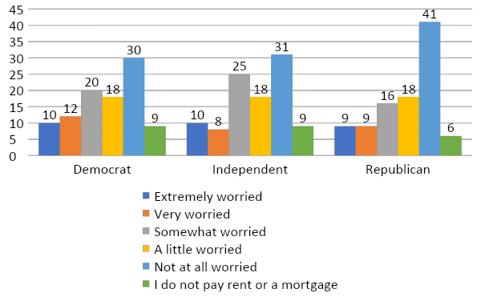
Ability to Pay for Housing
How worried are you about being able to pay your rent or mortgage?
Pluralities of young adults across parties report that they are ’not at all worried’ about their ability to pay their rent or mortgage.
Percent who are extremely or very worried about their ability to pay rent or mortgage:
  Democrats = 22%
  Independents = 18%
  Republicans = 18%

Slide 20
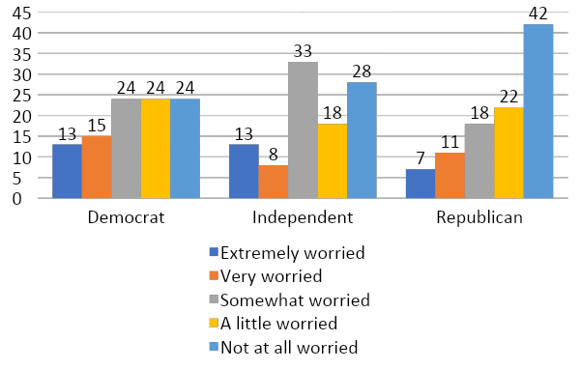
Keeping a Job or Finding a Good Job in the Future
How worried are you about keeping your current job or finding a good job in the future?
Young adults across parties share little worry about their future job prospects. Independents most commonly will respond saying they are somewhat worried (33%). Republicans most often respond that they are not at all worried (42%). For Democrats, the responses for somewhat worried, a little worried, and not at all worried are evenly split with 24% of the responses each.
Percent who are extremely or very worried about their job:
  Democrats = 28%
  Independents = 21%
  Republicans = 18%

Slide 21
Most important issue
What do you think is the most important problem facing this country today? Please select which one of these is the most important.
Independents and Democrats have strong overlap in the issues that they deem the most important ones facing this country today. For each of the three top issues Democrats listed as the most important, it is in the top issues for Independents, as well. There are no overlaps in the top issues for Republicans and Democrats. However, the second top issue for Republicans, Health care, is a top issue for Independents.
 | Democrat | Independent | Republican
1st | Environment and climate change (19%) | Environment and climate change / Health care (10%) | Immigration (12%)
2nd | Racism (11%) | Gun control / Racism (8%) | Health care (9%)
3rd | Gun control (10%) | Education (7%) | Economic growth (7%)

Slide 22
Support for 2020 Democratic candidates
Below is a list of people who may be running in the Democratic primaries to be the party’s presidential nominee. Which one candidate do you support or do you support someone else?
Among Democratic young adults, Bernie Sanders is the top Democratic presidential candidate with 26% support, followed by former Vice-President Biden with 17% support.
Among Independent young adults, the top Democratic presidential candidate is Senator Sanders with 10% support followed by Former VP Biden with 6%. However, Independents currently prefer someone else by a large margin, at 50%.
Among Republican young adults, the top Democratic presidential candidate is Former VP Biden with 11%, followed by Senator Sanders with 5%. However, Republicans want someone else by a large margin, at 47%
 | Democrat | Independent | Republican
Vermont Senator Bernie Sanders | 26 | 10 | 6
Former Vice President Joe Biden | 17 | 6 | 11
Massachusetts Senator Elizabeth Warren | 14 | 5 | 3
California Senator Kamala Harris | 6 | 3 | 3
South Bend Mayor Pete Buttigieg | 4 | 2 | 2
Former Tech Executive Andrew Yang | 5 | 5 | 7
Former Texas Congressman Beto O'Rourke | 3 | 2 | 2
Someone else | 9 | 50 | 47

Slide 23
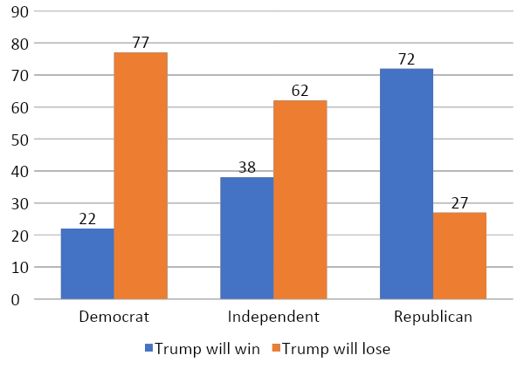
Trump’s Electoral Chances
As you may have heard, Donald Trump has decided to run for re-election. Please just give me your best guess, do you think he will win the presidential election in 2020, or do you think he will lose?
Most young Republicans are confident in Trump’s reelection, with 72% believing that Trump will win in 2020 compared to 22% of Democrats. Independents are split with 38% believing Trump will win.
Percent who say Trump will win:
  Democrats = 22%
  Independents = 38%
  Republicans = 76%

Slide 24
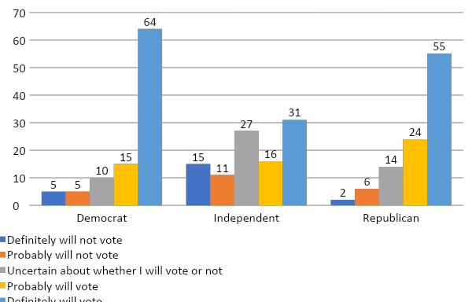
2020 Election Vote Intentions
How likely are you to vote in the presidential election being held in November 2020?
Young adults who identify as Independents are the least likely group to say they plan to vote with 26% reporting they definitely or probably will not vote in November 2020. Another 27% of Independent young adults are unsure about whether or not they will vote. Majorities of Republicans (79%) and Democrats (79%) indicate that they probably or definitely will vote in 2020.
Percent who say they “definitely” or ”probably” will vote:
Democrats = 79%
Independents = 47%
Republicans = 79%

Slide 25
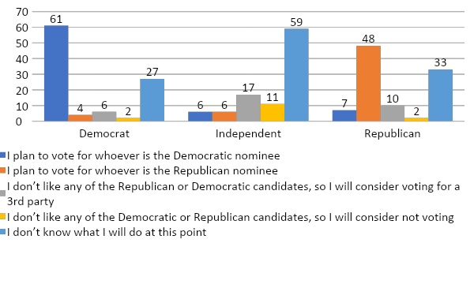
2020 Election Intentions
We know it is early in the 2020 election season and many people have not been focusing on the presidential election. Given what you know about the candidates running for president which statement is closest to how you feel:
The majority of Democrat (61%) and a plurality of Republican (48%) young adults plan to vote their party in the upcoming presidential election. It is important to note that there are pockets of Democrats and Republicans who don’t know what they will do, with 27% of Democrats and 33% of Republicans indicating that they are uncertain. The majority of Independents, 59%, are uncertain, as well.

Slide 26
Candidate Qualities
Which one candidate quality matters most in deciding for whom to vote in the 2020 presidential election?
The ability to bring about needed change is the most important quality for a candidate in the presidential election with 28% of Democrats, 22% of Independents, and 22% of Republicans registering their preference for that quality. It is the most important candidate quality for both Democrats and Republicans. Independents are still uncertain in what they are looking for in a candidate with 24% indicating they are “unsure” what candidate quality matters most.
 | Democrat | Independent | Republican
1st | Can bring about needed change (28%) | Unsure (24%) | Can bring about needed change (22%)
2nd | Honest and trustworthy (14%) | Honest and trustworthy (23%) | Shares my values (15%)
3rd | Cares about people like me (11%) | Can bring about needed change (22%) | Honest and trustworthy (13%)

Slide 27
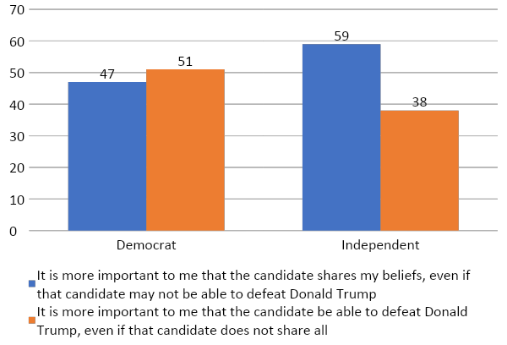
Candidate Beliefs and Electability
In thinking about which candidate should receive the Democratic Party's nomination, which of the following best describes your view:
A slim majority of Democrats (51%) young adults say it is more important that the Democratic Party candidate can beat Trump, even if the candidate does not share all of their beliefs. The majority of Independents (59%) say it is more important that the candidate shares their beliefs, even if they may not be able to defeat Donald Trump.

Slide 28
2020 Presidential Election Hypothetical Match-Ups
Now thinking about the general election, if the 2020 presidential election were being held today…for whom would you vote?
In a hypothetical election between Donald Trump and the top performing Democratic hopefuls vying for the nomination, Bernie Sanders has the largest lead for both Democrats (83%) and Independents (53%). For Democrats, Joe Biden is a close second with 81%. Independents, on the other hand, had Julian Castro as the second with 40%. For Republicans, the hypothetical match-up kept Trump winning, but Andrew Yang was the best nominee with -52%.
Donald Trump and… | Democrat | Independent | Republican
Joe Biden | +81 | +32 | -56
Elizabeth Warren | +75 | +30 | -61
Bernie Sanders | +83 | +53 | -59
Kamala Harris | +75 | +24 | -65
Pete Buttigieg | +74 | +32 | -61
Cory Booker | +73 | +27 | -59
Beto O’Rourke | +75 | +14 | -65
Andrew Yang | +75 | +37 | -52
Julian Castro | +77 | +40 | -65
Amy Klobuchar | +71 | +22 | -58
*Net advantage calculated as Democratic candidate support minus Trump support

Slide 29
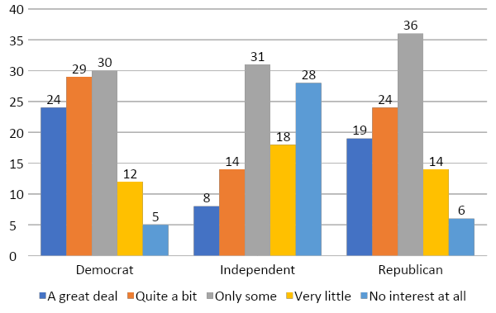
Interest in 2020 Presidential Election News
How much interest do you have in following news about the 2020 presidential election? A great deal, quite a bit, only some, very little, or no interest at all?
Interest in the upcoming presidential election is highest for Democratic young adults (63% interest). Pluralities of Republicans (36%) and Independents (31%) report having only some interest.
Percent with a great deal or quite a bit of interest:
  Democrats = 63%
  Independents = 22%
  Republicans = 43%

Slide 30
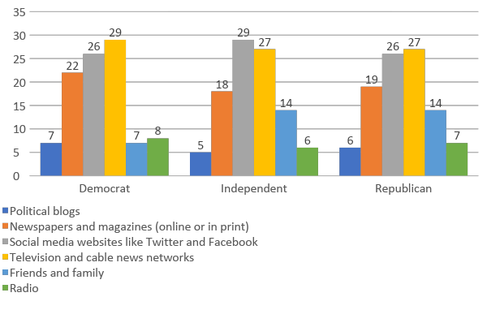
Sources for Political News and Information
What is your primary source for political news and information?
Across party, young adults are getting their political news and information primarily from social media sites and television and cable news networks. It is uncommon for these young adults to gather their political news from either the radio or political blogs. Unlike their political counterparts who each report 14% receiving information from friends and family, young adult Democrats report only 7% receiving information from friends and family.

Slide 31
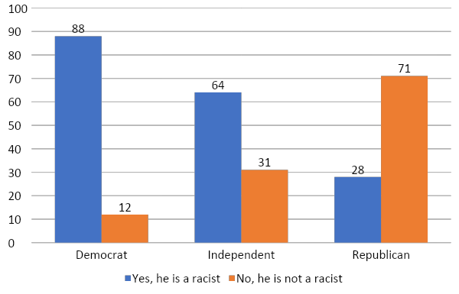
Is Donald Trump a Racist?
Do you believe Donald Trump is a racist or is not a racist?
Significant majorities of young adult Democrats believe Trump is a racist (88%). A majority of Independents also believe Trump to be a racist (64%). Republicans on the other hand do not believe Trump to be a racist with only 28% agreeing.
Percent who say Donald Trump is not a racist:
Democrats = 12%
Independents = 31%
Republicans = 71%
Whites= 46%

Slide 32
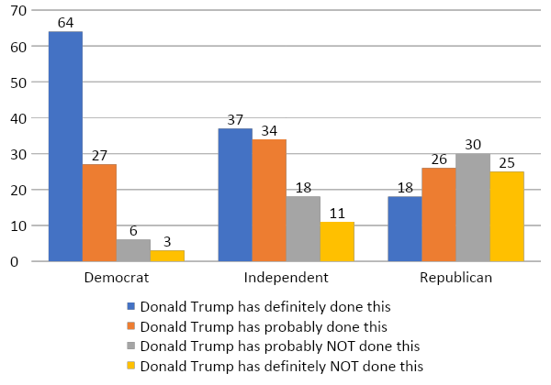
Donald Trump Improperly Enriching Himself and Others
Since taking office, do you think Donald Trump has improperly used his office to enrich himself or his friends and family?
Significant majorities of young adult Democrats say Donald Trump has improperly used his office, with 91% saying he has definitely or probably improperly used his office to enrich himself or his friends and family. A majority (71%) of Independents agree. Republicans are less prone to agree with only 44% believing Trump has improperly used his office.
Percent who say Donald Trump has “definitely” or ”probably” done this:
Democrats = 91%
Independents = 71%
Republicans = 44%

Slide 33
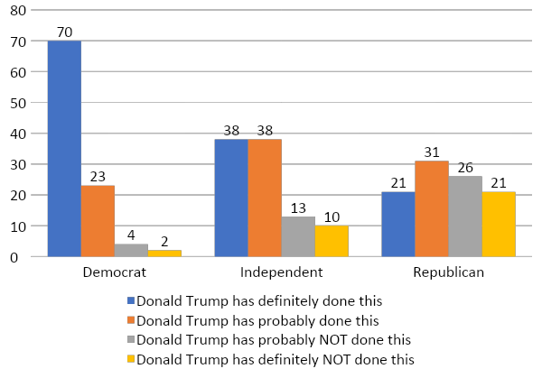
Donald Trump Improperly Attacking Political Opponents
Since taking office, do you think Donald Trump has improperly used his office to attack his political opponents?
Majorities of young adults across parties believe that Donald Trump has definitely or probably improperly used his office to attack his political opponents—with 93% of Democrats, 76% of Independents, and 52% of Republicans agreeing.
Percent who say Donald Trump has “definitely” or ”probably” done this:
Democrats = 93%
Independents = 76%
Republicans = 52%

Slide 34
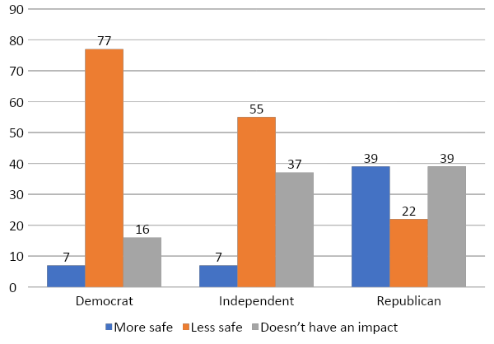
Donald Trump and Personal Safety
Does having Donald Trump as president of the United States make you feel more safe, less safe, or doesn't it have an impact on how safe you feel?
Majorities of both Democrats (77%) and Independents (55%) feel less safe having Donald Trump as president. Republicans are split on the matter with 39% feeling more safe and 39% believing his presidency has no impact.
Percent who say they feel more safe:
Democrats = 7%
Independents = 7%
Republicans = 39%

Slide 35
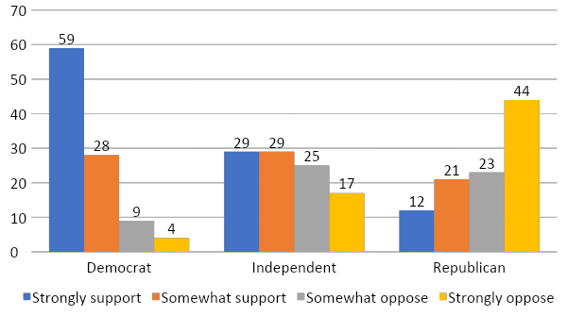
House Impeachment Proceedings
Speaker of the House Nancy Pelosi recently announced that the House of Representatives would formally begin impeachment proceedings on President Donald Trump based on a whistleblower complaint alleging wrongdoing. Do you support or oppose the House of Representatives holding impeachment proceedings?
Support of the House of Representatives holding impeachment hearings is strongest among young Democrats with 87% strongly or somewhat supporting. There is a majority of Independents strongly or somewhat supporting (58%), and Republicans are less supportive with 33% strongly or somewhat supporting.
Percent who say they “strongly” or ”somewhat” support:
Democrats = 87%
Independents = 58%
Republicans = 33%

Slide 36
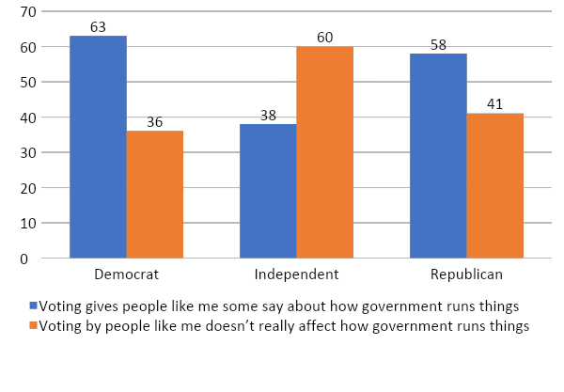
Voting and Personal Efficacy
Which statement comes closer to your views, even if neither is exactly right?
Democratic and Republican young adults believe that voting gives them a say about how the government runs things—with 63% of Democrats and 58% of Republicans agreeing. In contrast, 60% of Independents believe that their vote does not really affect how the government runs things.
Percent saying voting gives them a say in government:
Democrats = 63%
Independents = 38%
Republicans = 58%

Slide 37
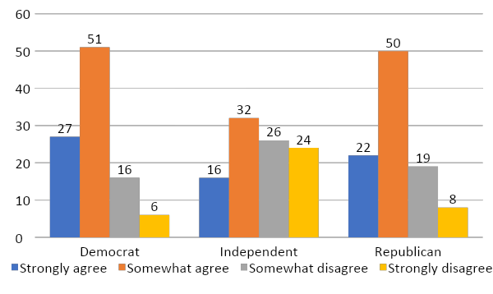
Participating in Politics Makes a Difference
Now we would like you to consider your role in politics, regardless of your formal citizenship status. Please indicate whether you strongly agree, somewhat agree, somewhat disagree, or strongly disagree with the following statement: I believe that by participating in politics I can make a difference.
Republican and Democrat young adults believe that they can make a difference by participating in politics. For Republicans, 72% somewhat or strongly agree, and Democrats somewhat or strongly agree 78% of the time. Independents are less convinced, with 48% agreeing.
Percent who say they somewhat or strongly agree:
Democrats = 78%
Independents = 48%
Republicans = 72%

Slide 38
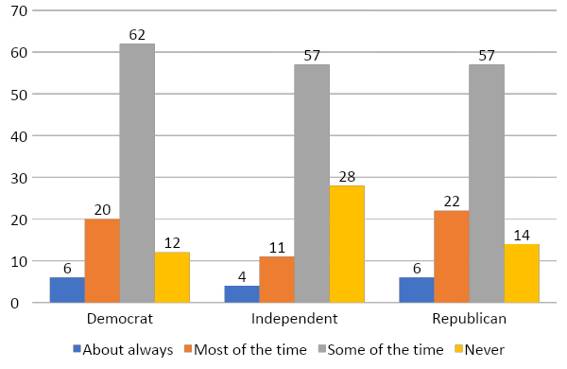
Trust in the Government in Washington
How much of the time do you think you can trust the government in Washington to do what is right? Just about always, most of the time, some of the time, or never?
Across parties, young adults do not have strong trust in the government in Washington. Majorities of Democrat (62%), Independent (57%), and Republican (57%) young adults say they can only trust the government in Washington to do what is right “some of the time”.
Percent who say they can trust the government in Washington about always:
Democrats = 6%
Independents = 4%
Republicans = 6%

Slide 39
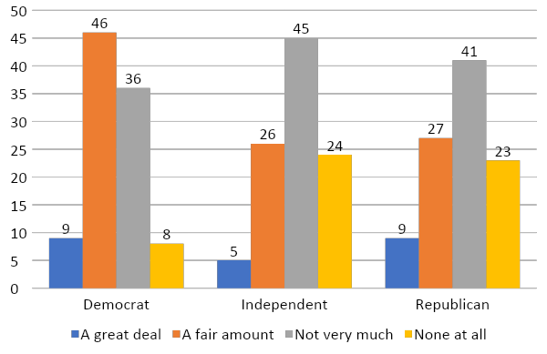
Trust in the Mass Media
In general, how much trust and confidence do you have in the mass media--such as newspapers, TV and radio--when it comes to reporting the news fully, accurately, and fairly--a great deal, a fair amount, not very much, or none at all?
Pluralities of Democrat young adults (48%) say they have a fair amount of trust and confidence in the mass media to report the news fully, accurately, and fairly. However, pluralities of Independents (45%) and Republicans (41%) indicate they have ”not very much” trust or confidence in the mass media.
Percent who say ”a great deal” or “a fair amount”:
Democrats = 55%
Independents = 31%
Republicans = 36%
GenForward surveys are available at www.genforwardsurvey.com

Slide 40
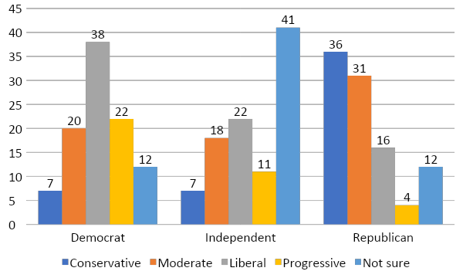
Social Ideological Self-Identification
Do you consider your views on social issues like abortion, gay marriage, and the death penalty to be generally conservative, moderate, liberal, or progressive?
Pluralities of Democrat young adults (38%) say they consider their views on social issues as liberal. Pluralities of Independent young adults (41%) indicate that they are not sure where they consider their views. Most Republicans consider themselves to be either conservative (36%) or moderate (31%)
Percent who say they are not sure about their social ideological self-identification:
Democrats = 12%
Independents = 41%
Republicans = 12%

Slide 41
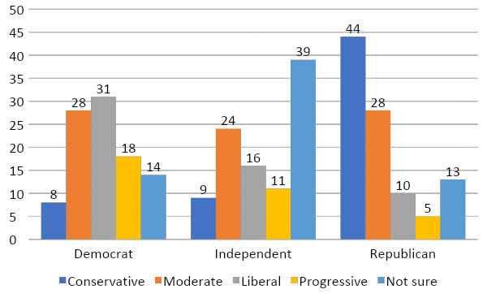
Economic Ideological Self-Identification
Do you consider your views on economic issues like taxes and social security to be generally conservative, moderate, liberal, or progressive?
Similar to social ideological self-identification, young adult Independents are unsure about their views on economic issues (39%). Pluralities of Republicans (44%) consider themselves to be conservative. Democrats indicate that they are either liberal (31%) or moderate (28%).
Percent who say they are not sure about their economic ideological self-identification:
Democrats = 14%
Independents = 39%
Republicans = 13%

Slide 42
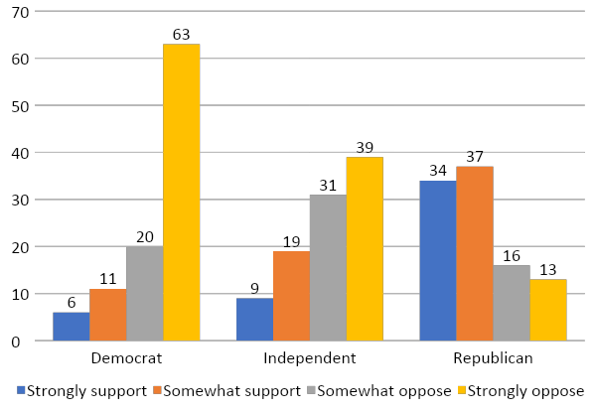
Building a Wall Along the Mexican Border
Do you support or oppose the United States building a wall along the Mexican border to help stop illegal immigration?
Support for building a wall along the Mexican border is led by Republicans with 71% strongly or somewhat supporting. There is little support among Democrats (17%) and Independents (28%).
Percent who somewhat or strongly oppose the border wall:
Democrats = 83%
Independents = 70%
Republicans = 29%

Slide 43
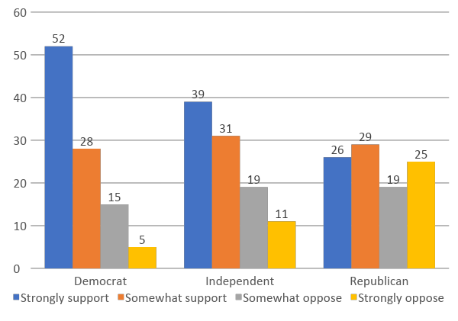
Free Tuition at Public Colleges
Do you support or oppose free tuition at public colleges?
Majorities of young adults across parties support free tuition at public colleges—with 80% of Democrats strongly or somewhat supporting this policy, followed by 70% of Independents and 55% of Republicans.
Percent who somewhat or strongly oppose free tuition at public colleges:
Democrats = 20%
Independents = 30%
Republicans = 44%

Slide 44
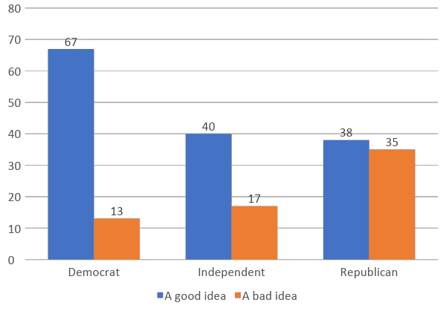
Wealth Tax
Do you think a wealth tax -- that is, a higher tax rate on income above one million dollars -- is a good idea or a bad idea?
A majority of young adult Democrats (67%) support the wealth tax. There is less support among Independents (40%) and Republicans (38%).

Slide 45
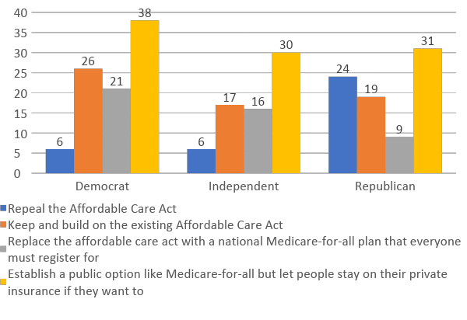
Health Care Reform
Which of the following approaches to expanding health care coverage to more Americans would you prefer?
Pluralities of young adults across parties support establishing a public option for health care coverage like Medicare-for-all, while allowing people to stay on their private insurance—38% of Democrats, 30% of Independents and 31% of Republicans supporting this policy.
Percent who support replacing the Affordable Care Act with a national Medicare-for-all plan:
Democrats = 21%
Independents = 16%
Republicans = 9%

Slide 46
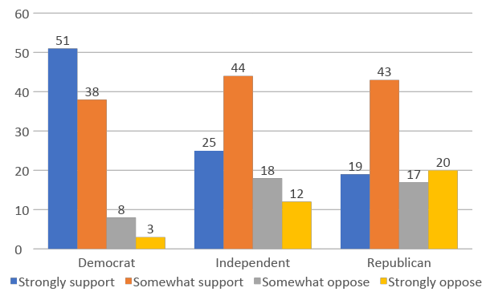
Green New Deal
Some in Congress have offered up a plan called the Green New Deal meant to address climate change and income inequality by focusing on creating clean energy jobs and ending our use of fossil fuel in the United States. Do you support or oppose the idea?
Majorities of young adults across party id strongly or somewhat strongly support The Green New Deal--with 89% of Democrats, 69% of Independents and 62% or Republicans registering support.
Percent who somewhat or strongly support the Green New Deal:
Democrats = 89%
Independents = 69%
Republicans = 62%

Slide 47
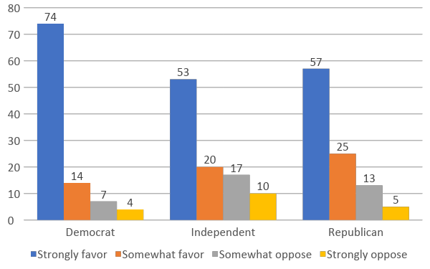
Background Checks for Gun Purchases
Do you favor or oppose requiring a background check on anyone attempting to purchase a gun in order to determine whether the prospective buyer has been convicted of a felony?
Large majorities of young people, across parties, strongly or somewhat favor background checks to buy a gun—with 88% of Democrats, 73% of Independents and 82% or Republicans supporting this policy.
Percent who somewhat or strongly oppose background checks:
Democrats = 11%
Independents = 27%
Republicans = 18%

Slide 48
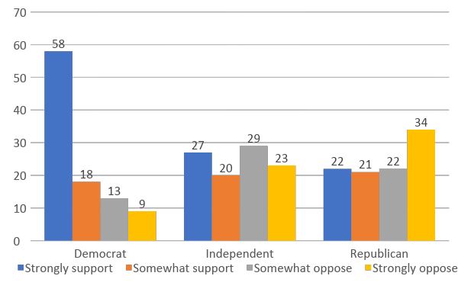
Banning the Sale of Assault Weapons
Would you support or oppose banning the sale of selected semi-automatic firearms referred to as assault weapons, such as the AR-15 and AK-47?
While majorities of Democrats (76%) strongly or somewhat support banning the sale of selected semi-automatic firearms, majorities of Independents (52%) and Republicans (56%) strongly or somewhat oppose the idea of banning the sale of selected semi-automatic firearms.
Percent who somewhat or strongly oppose the ban:
Democrats = 22%
Independents = 52%
Republicans = 56%

Slide 49
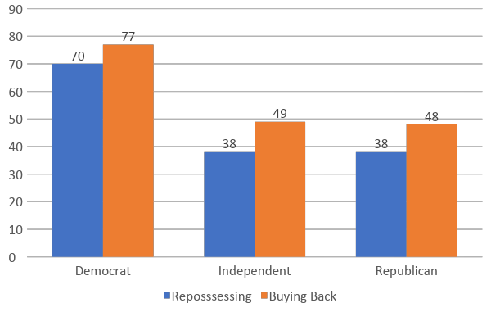
Repossessing Versus Buying Back Assault Weapons
Percent support for the government [repossessing / buying back] selected semi-automatic firearms referred to as assault weapons, such as the AR-15 and AK-47:
When asked about supporting buying back assault weapons and supporting repossessing assault weapons, majorities of Democrats support both programs (70% support for repossessing and 77% support for buying back). No majorities of Independents nor Republicans support either program.

Slide 50
Support for Reparations Measures for African Americans
Here are some things some people have suggested government and other institutions like universities should do for African Americans to make up for the lasting impact of slavery and racial discrimination such as Jim Crow. Do you think they should provide African Americans with…
A majority of young Democrats (53%) support a ”thorough and accurate public education curriculum on Black history,” compared to 33% of Independents, and 21% of Republicans.
The majority of Republicans (51%) believe the government and other institutions should “do nothing” compared to 32% of Independents and 16% of Democrats.
 | Democrat | Independent | Republican
Full and free access to public education across one’s lifetime | 46 | 30 | 19
Retroactive forgiveness of student loans | 36 | 17 | 12
Guaranteed minimum living wage | 40 | 25 | 13
Thorough and accurate public education curriculum on Black history | 53 | 33 | 21
Cash payments | 21 | 19 | 8
Free healthcare | 30 | 26 | 9
Do nothing | 16 | 32 | 51

Slide 51
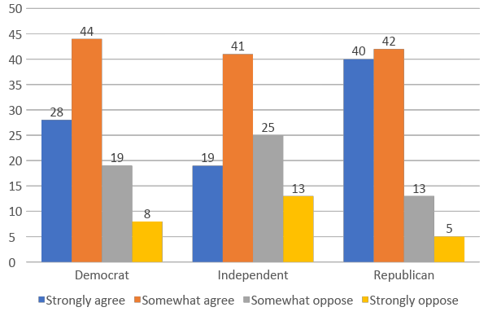
Full and Equal Citizen
Please tell us how strongly you agree or disagree with the following statements. Generally, I feel like a full and equal citizen in this country with all the rights and protections that other people have.
Across party ID, young adults report that they feel like a full and equal citizen. The largest majority is for young adult Republicans with 82% reporting that they strongly or somewhat agree. For Democrats, 72% agree and 60% of Independents agree.
Percent saying they strongly disagree:
Democrats = 27%
Independents = 38%
Republicans = 18%

Slide 52
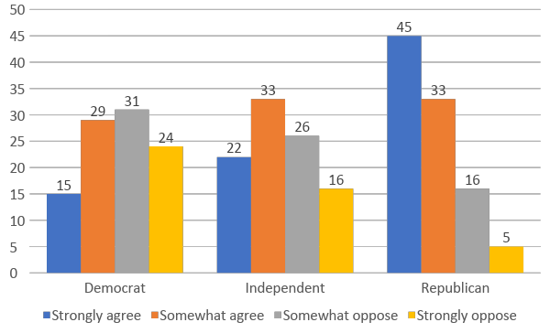
Work their Way Up
Please tell us how strongly you agree or disagree with the following statements. Irish, Italian, Jewish, and many other minorities overcame prejudice and worked their way up. Blacks should do the same without any special favors.
In thinking about whether or not Blacks should be able to overcome prejudice without any special favors, Independents and Republicans are more likely to agree. A vast majority of Republicans expect African Americans to be able to work their way up without special favors (78%) and 55% of Independents agree. For young Democrats, a slim majority disagree (55%) with the statement that Blacks should work their way up without special favors as Irish, Italian, and Jews did.
Percent who strongly or somewhat agree :
  Democrats = 44%
  Independents = 55%
  Republicans = 78%

Slide 53
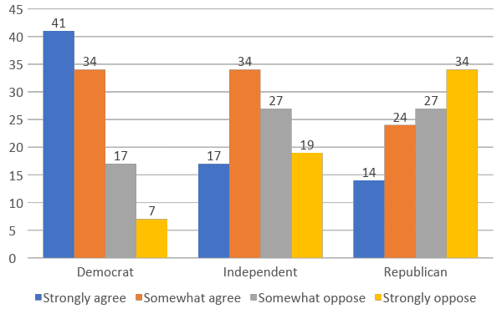
Generations of Slavery
Please tell us how strongly you agree or disagree with the following statements. Generations of slavery and discrimination have created conditions that make it difficult for blacks to work their way out of the lower class.
Majorities of young people, both Democrat and Independent, somewhat or strongly agree that generations of slavery and discrimination has made it difficult for blacks to work their way out of the lower class (75% Democrat and 51% Independent). The majority of Republicans do not agree with only 38% somewhat or strongly agreeing.
Percent who somewhat or strongly agree:
  Democrats = 75%
  Independents = 51%
  Republicans = 38%

Slide 54
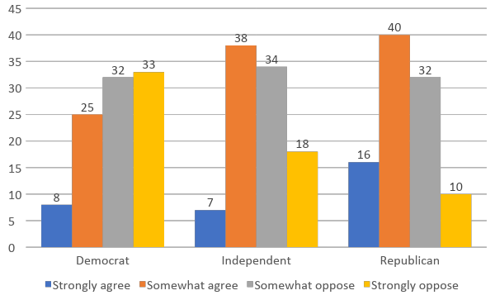
Whites Economically Losing Ground
Do you agree or disagree that, through no fault of their own, whites are economically losing ground today compared to other racial and ethnic groups?
A majority of Democrats (65%) and a slim majority of Independents (52%) disagree that whites are economically losing ground. However, a majority of Republicans (56%) agree that whites are losing ground.
Percent who say that whites are not losing ground economically:
  Democrats = 55%
  Independents = 52%
  Republicans = 42%

Slide 55
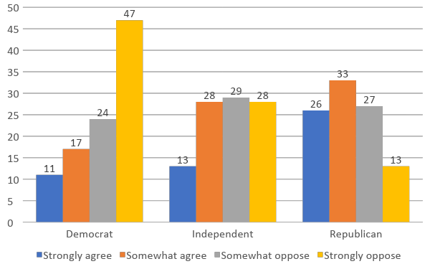
Discrimination Against Whites
Do you agree or disagree that discrimination against whites has become as big a problem as discrimination against blacks and other minorities?
A plurality of Democrats (47%) strongly oppose the idea that discrimination has become a big problem. The majority of Independents (57%) somewhat or strongly oppose compared to 40% of Republicans.
Those who somewhat or strongly agree that discrimination against whites has become a problem:
  Democrats = 28%
  Independents = 41%
  Republicans = 59%

Slide 56
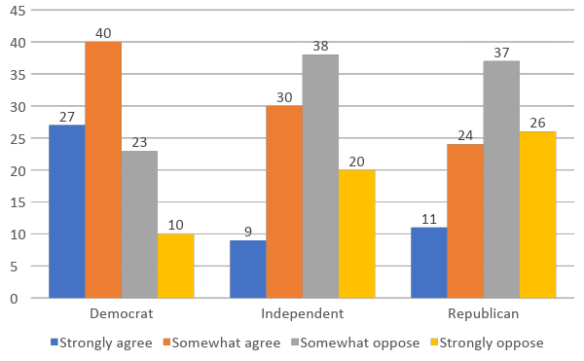
Feminist Demands of Men
Please indicate how much you agree or disagree with the following statement: Feminists are making entirely reasonable demands of men.
Majorities of Independent (58%) and Republican (63%) young adults somewhat or strongly disagree that feminists are making entirely reasonable demands of men. The majority of Democrats (67%) agree that feminists are making entirely reasonable demands.
Percent who somewhat or strongly disagree:
  Democrats = 33%
  Independents = 58%
  Republicans = 63%

Slide 57
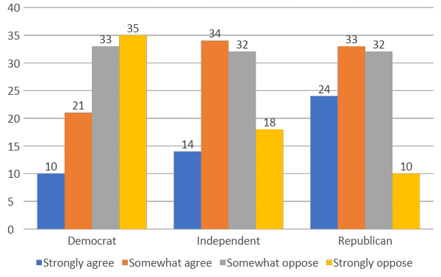
Discrimination Against Women
Please indicate how much you agree or disagree with the following statement: Women who complain about discrimination often cause more problems than they solve.
A vast majority of Democrats (78%) and a slim majority of Independents (50%) disagree with the idea that women who complain about discrimination cause more problems than they solve. 42% of Republicans disagree.
Percent who somewhat or strongly agree:
  Democrats = 31%
  Independents = 48%
  Republicans = 57%

Slide 58
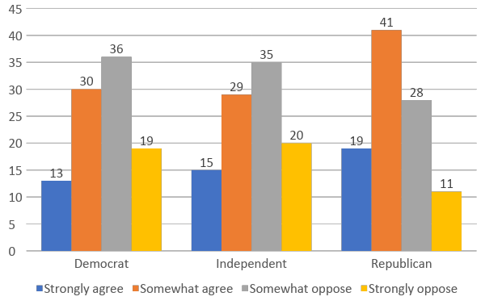
Men Provide Financially for Women
Please indicate how much you agree or disagree with the following statement: Men should be willing to sacrifice to provide financially for women.
Majorities of Democrats (55%), and Independents (55%) disagree that men should be willing to sacrifice to provide financially for women. However, the majority of Republican (60%) young adults agree.
Percent who somewhat or strongly agree:
  Democrats = 43%
  Independents = 44%
  Republicans = 60%

Slide 59
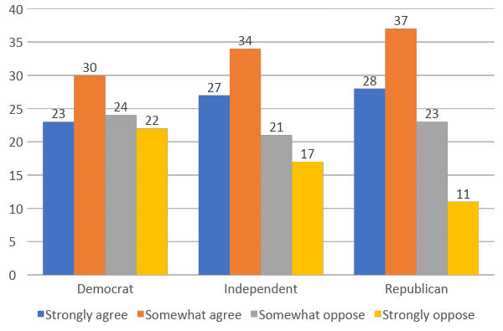
Men Ought to Have a Woman to Adore
Please indicate how much you agree or disagree with the following statement: Every man ought to have a woman whom he adores.
Majorities of Republican (65%), Democrat (53%), and Independent (61%) young adults somewhat or strongly agree that every man ought to have a woman whom he adores.
Percent who somewhat or strongly disagree:
  Democrats = 46%
  Independents = 38%
  Republicans = 34%

Slide 60
Survey Methodology

Slide 61
Survey Methodology (1 of 3)
The GenForward October survey is a project of Professor Cathy J. Cohen at the University of Chicago. Interviews were conducted with a representative sample from GenForwardSM, a nationally representative survey panel of adults ages 18-36 recruited and administered by NORC at the University of Chicago.
A total of 2,994 interviews were conducted between September 27th and October 10th, 2019 with adults ages 18-36, including completed interviews with 883 African American young adults, 527 Asian American young adults, 801 Latinx young adults, 775 white young adults, and 58 young adults with other racial and ethnic backgrounds. The survey was offered in English and Spanish and via telephone and web modes.
The GenForward survey was built from two sample sources:
Fifty-nine percent of the completed interviews are sourced from NORC’s AmeriSpeak® Panel and from the Black Youth Project (BYP) panel of young adults recruited by NORC. AmeriSpeak is a probability-based panel that also uses address-based sample but sourced from the NORC National Frame with enhanced sample coverage. During the initial recruitment phase of the AmeriSpeak panel, randomly selected U.S. households were sampled with a known, non-zero probability of selection and then contacted by U.S. mail, email, telephone, and field interviewers (face-to-face). The BYP sample is from a probability-based household panel that uses an address-based sample from a registered voter database of the entire U.S. Households were selected using stratified random sampling to support over-sampling of households with African Americans, Latinxs, and Asian Americans ages 18-36. NORC contacted sampled households by U.S. mail and by telephone, inviting them to register and participate in public opinion surveys twice a month.

Slide 62
Survey Methodology (2 of 3)
The AmeriSpeak panel sample was supplemented with respondents from the Dynata nonprobability online opt-in panel. Forty-one percent of the completed interviews are sourced from the Dynata panel. To help to reduce potential bias in the nonprobability sample, Dynata attempted to balance the nonprobability respondent sample by age, race and ethnicity, gender, and partisanship. In order to incorporate the nonprobability sample, NORC used TrueNorth calibration services, an innovative hybrid calibration approach developed at NORC based on small area estimation methods in order to explicitly account for potential bias associated with the nonprobability sample. The purpose of TrueNorth calibration is to adjust the weights for the nonprobability sample so as to bring weighted distributions of the nonprobability sample in line with the population distribution for characteristics correlated with the survey variables. Such calibration adjustments help to reduce potential bias, yielding more accurate population estimates.
Panelists on both the BYP and AmeriSpeak panels are invited to register for the panel via the web or by telephone to participate in public opinion surveys.
Of the 2,994 completed interviews in the GenForward July survey, 97 percent were completed by web and 3 percent by telephone. The survey completion rate is 20.3 percent. The weighted AAPOR RR3 panel recruitment rate is 19.8 percent and the weighted household panel retention rate is 85.5 percent, for a cumulative AAPOR Response Rate 3 of 3.4 percent. The overall margin of sampling error is +/- 2.60 percentage points at the 95 percent confidence level, including the design effect. Among subgroups, the margin of sampling error at the 95 percent confidence level is +/- 4.27 percentage points for African Americans, +/- 5.44 percentage points for Asian Americans, +/- 5.44 percentage points for Latinxs, and +/- 4.11 percentage points for whites.
To encourage cooperation, respondents were offered incentives for completing the survey that ranged from the cash-equivalent of $3 to the cash-equivalent of $10.

Slide 63
Survey Methodology (3 of 3)
The interviews from the two probability-based sample sources were combined for statistical weighting and analysis. The combined panel samples provide sample coverage of approximately 97% of the U.S. household population. Those excluded from the sample include people with P.O. Box only addresses, some addresses not listed in the USPS Delivery Sequence File, and some newly constructed dwellings. The statistical weights incorporate the appropriate probability of selection for the BYP and AmeriSpeak samples, nonresponse adjustments, and also, raking ratio adjustments to population benchmarks for 18-64-year-old adults. A poststratification process is used to adjust for any survey nonresponse as well as any non-coverage or under- and over-sampling resulting from the study-specific sample design. The poststratification process was done separately for each racial/ethnic group and involved the following variables: age, gender, education, and census region. The weighted data, which reflect the U.S. population of adults ages 18-36, and the 18-36-year-old populations for African Americans, Latinxs, Asian Americans, and non-Latinx whites, were used for all analyses.

Slide 64
Full details are available at www.genforwardsurvey.com

